Slide 1
Quant Equity Ratings model universe

Slide 2
SUMMARY
Quant Equity Ratings are based upon a rules-based, systematic approach that evaluates each stock based on a wide variety of investment criteria from five broad categories: Growth, Quality, Valuation, Profitability and Momentum.

Slide 3
FACTOR ANALYSIS
RSI
MACD
Super Trend
1. GROWTH
Sales growth
EPS growth
SSGR
2. QUALITY
Debt Management
Asset Management
Liquidity
3. VALUATION
Price to Earnings
Price to FCF
EV/EBITDA
ROCE
EBITDA margin
Dividend Yield
5. MOMENTUM
4. PROFITABILITY

Slide 4
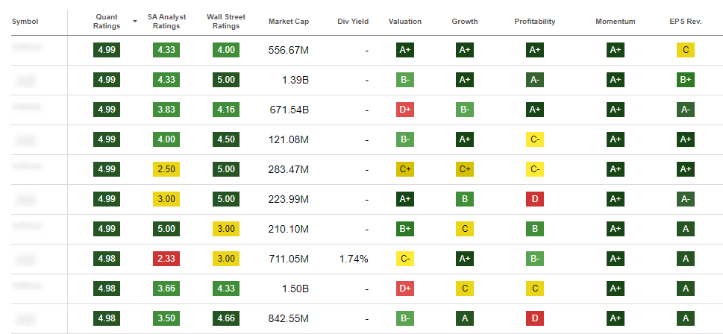
stocks universe ranked by quant score
Growth
Quality
Valuation
Profitability
Momentum

Slide 5
rules based approach
Universe
Position Sizing
Screening
Selection
Companies in Large, mid and small cap segment
for accounting red flags
basis Factor Analysis
basis value metric
Model Portfolio

Slide 6
QUANT FRAMEWORK
Screening
Selection
Position Sizing
Leverage algos derived from academic research to eliminate stocks with red flags i.e., poor quality of accounts and corporate governance.
Greatly minimize chances of poor performers or poor-quality companies entering the investment universe.
Focus on earnings growth + earnings quality with ideal valuations and strong momentum.
Concentrated Portfolios deliver best returns as returns do not get average out.
Long term orientation with low churn to realize the power of compounding.

Slide 7
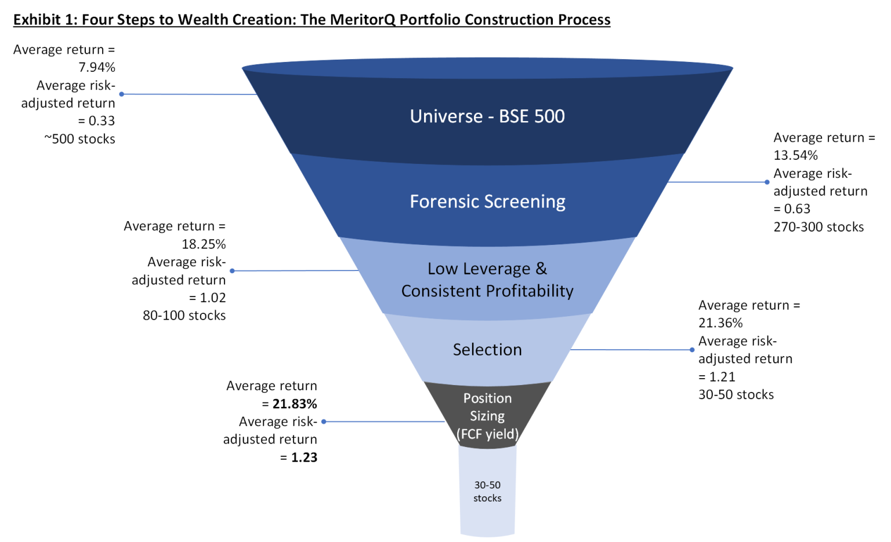
ALPHA GENERATION AT EVERY FILTER

Slide 8
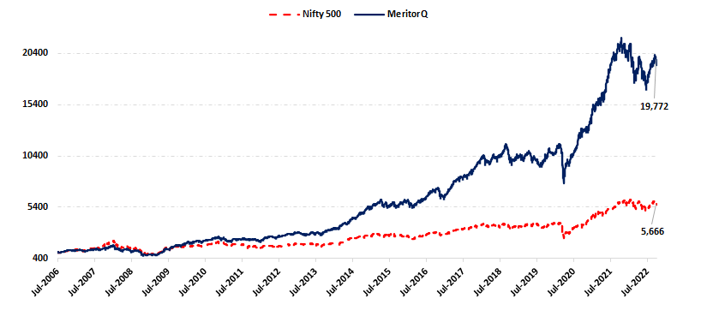
Back tested performance of QUANT MODEL PORTFOLIO
Nifty 500
Quant Model Portfolio

